Slide 1
HTML5&CSS3 Day2 presented by: Asmaa Ahmed

Slide 2
What’s CSS 3?
CSS3 is completely backwards compatible, so you will not have to change existing designs. Browsers will always support CSS2.
The CSS3 specification is still under development by W3C, However, many of the new CSS3 properties have been implemented in modern browsers.

Slide 3
What’s CSS 3?
CSS3 Modules:
CSS3 is split up into "modules".
The old specification has been split into smaller pieces, and new ones are also added.
Some of the most important CSS3 modules are: Selectors ,Box Model , Backgrounds and Borders , Text Effects , 2D/3D Transformations , Animations , Multiple Column Layout , User Interface .

Slide 4
Vendor Prefix
Browser vendors are working to stop using vendor prefixes for experimental features. Web developers have been using them on production Web sites, despite their experimental nature. This has made it more difficult for browser vendors to ensure compatibility and to work on new features.
Read More:
https://developer.mozilla.org/en-US/docs/Glossary/Vendor_Prefix

Slide 5
Box Model
All HTML elements can be considered as boxes. 
The Box Model allows us to place a border around elements and space elements in relation to other elements.
The Box Model consists of:
margins
borders
padding
and the actual content.

Slide 6
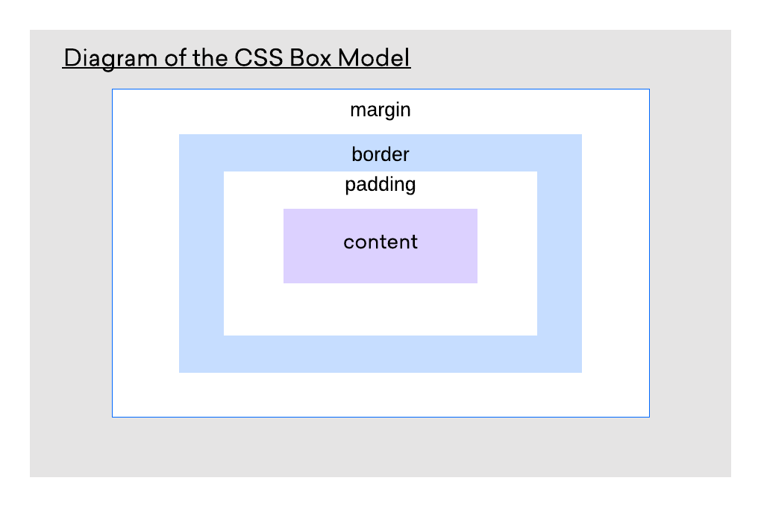
Box Model

Slide 7
CSS 3 Fonts
Font family: https://www.w3schools.com/css/css_font.asp
Web safe fonts :
https://www.w3schools.com/cssref/css_websafe_fonts.asp

Slide 8
CSS 3 Fonts
Custom fonts : https://www.fontspace.com/category/custom
Web fonts : https://fonts.google.com/
Font Icons: https://fontawesome.com/v5.15/icons?d=gallery&p=2
Font awesome download link:
https://fontawesome.com/v5.15/how-to-use/on-the-desktop/setup/getting-started

Slide 9
CSS 3 Fonts
Font awesome cdn:
<link rel="stylesheet" href="https://pro.fontawesome.com/releases/v5.10.0/css/all.css" integrity="sha384-AYmEC3Yw5cVb3ZcuHtOA93w35dYTsvhLPVnYs9eStHfGJvOvKxVfELGroGkvsg+p" crossorigin="anonymous"/>

Slide 10
Thanks!
Any questions?

